Slide 1


MarketNews
17/07/2026

Slide 2



EUR/USD
MetaTrader4

Slide 3

Support Level : 1.1380 - 1.1300 - 1.1200
Resistance Level : 1.1482 - 1.1600 - 1.1680
EUR/USD
EUR/USD trades lower near the 1.1440 area on Thursday, retreating around 0.2% as the US Dollar (USD) gains support from stronger-than-expected United States (US) labor market data.
US Initial Jobless Claims fell to 208K in the week ending July 11, below expectations of 217K and the previous 216K. The figures indicate that layoffs remain limited, supporting the Greenback despite signs of softer consumer spending.
In the Eurozone, investors await June inflation data. Core Harmonized Index of Consumer Prices (HICP) inflation is expected to remain at 2.4% YoY and 0.2% MoM, while headline HICP is forecast to decline 0.1% on the month. A softer inflation reading could strengthen expectations of a less restrictive European Central Bank (ECB) policy stance and place additional pressure on the Euro.
The EUR/USD pair is trading near 1.1440, down for the day and above 21 SMA, indicates bullish strength in short term. Meanwhile, the 50 and 100 SMA still pressure the market, suggests bears not exhausted yet. On upside, the immediate resistance is 1.1482, break above this level will extend the advance to 1.1600.
Technical readings in the daily chart support the bearish stance. The RSI indicator stabilizes around 47. The Momentum indicator holds below the midline, indicating downward potentials. On downside, the immediate support is 1.1380 and below this level will open the gate to 1.1300.

Slide 4
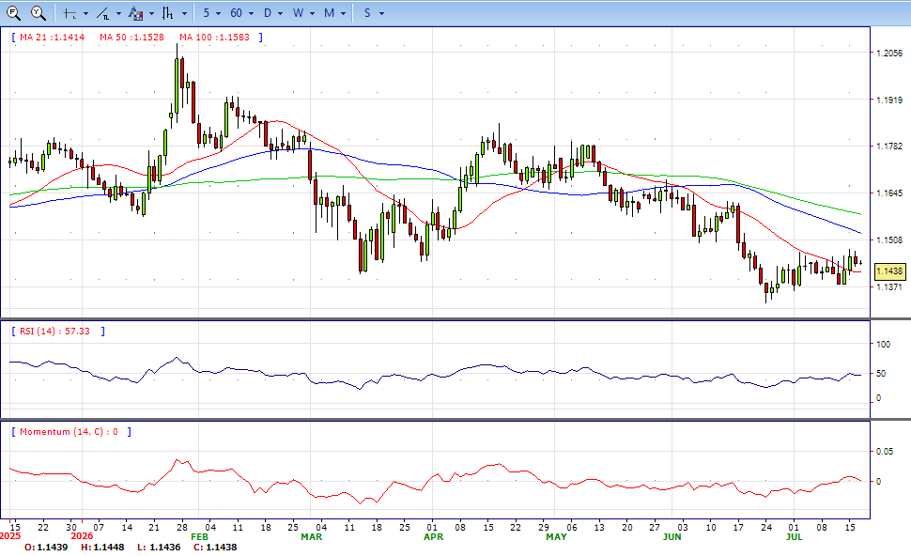
EURUSD daily

Slide 5
GBP/USD
MetaTrader4

Slide 6
Support Level: 1.3400 - 1.3300 - 1.3200
Resistance Level: 1.3550- 1.3650 - 1.3700
GBP/USD
The Pound Sterling GBP/USD tumbles below 1.3500 on stronger Dollar. The Pound Sterling trims some of its Wednesday gains versus the US Dollar, down by over 0.48% following solid US data. The sell-off comes amid risk aversion and augments the safe-haven appeal of the Greenback.
US Retail Sales in June increased 0.2% MoM, as expected. Gasoline prices eased from $4.61 in May to $4.18 in the last month, leaving consumers with free money for discretionary spending. Excluding gasoline and autos, Retail Sales expanded 0.4% MoM, down from 0.5%. Other US data showed that jobless claims for the week ending July 11 fell from 216K to 208K, below estimates for a 217K increase. On Wednesday, the Federal Reserve’s (Fed) Beige Book noted that the “employment rose on balance,” in July, with some districts “showing modest, moderate or solid gains.”
The GBP/USD pair is trading near 1.3470, down for the day but still trades above 21 SMA, indicates bullish strength in short term. Meanwhile, the breakthrough of both 50 and 100 SMA provide bull signal. On upside, the immediate resistance is 1.3550, break above this level will extend the advance to 1.3650.
Technical readings in the daily chart support the bullish stances. RSI indicator stabilizes around 58, while the Momentum indicator stabilizes above the midline, suggesting upward potentials. On downside, the immediate support is 1.3400, unable to defend this level will resume the decline to 1.3300.

Slide 7
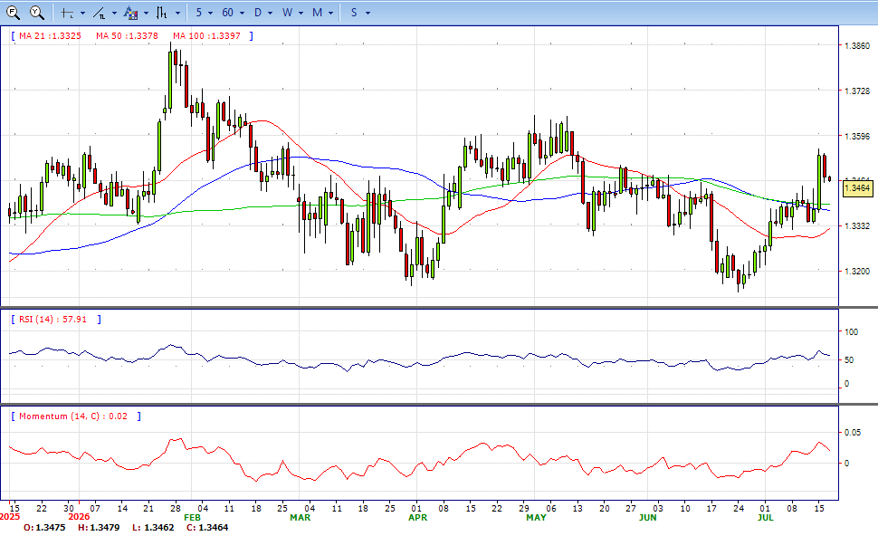
GBPUSD DAILY

Slide 8
XAU/USD
MetaTrader4

Slide 9
Support Level : 3900 - 3700 - 3500
Resistance Level : 4180 - 4380 - 4520
XAU/USD
Gold price drops over 1.80% as tensions between the US and Iran fuel fears of a possible Oil supply disruption, driving energy prices higher and potentially triggering another round of inflation.
The effects of the Middle East conflict are well reflected by the strength of the US Dollar. The Greenback is up some 0.24%, as measured by the US Dollar Index (DXY). The DXY, which tracks the buck’s value against its peers, is at 100.74, still shy of revisiting the 101.00 mark.
US jobs data was also solid, as Initial Jobless Claims for the week ending July 11 came at 208K, beneath forecasts of a 217K increase. The Fed’s Beige Book acknowledged that the labour market is strong, with some districts showing “modest, moderate or solid gains.”
The XAU/USD pair is trading near 3980, down for the day. The pair stabilized below 21 SMA, indicates bearish strength in short term. Meanwhile, the 21 SMA continued developing below longer ones, suggests downward potentials. On upside, the immediate resistance is 4180, break above this level will extend the advance to 4380.
From a technical perspective, the RSI indicator holds below the midline and stabilizes around 38, on a bearish stance. While the Momentum indicator stabilized below the midline, suggests downward potentials. On downside, the immediate support is 3900, below this area may resume the decline to 3700.

Slide 10
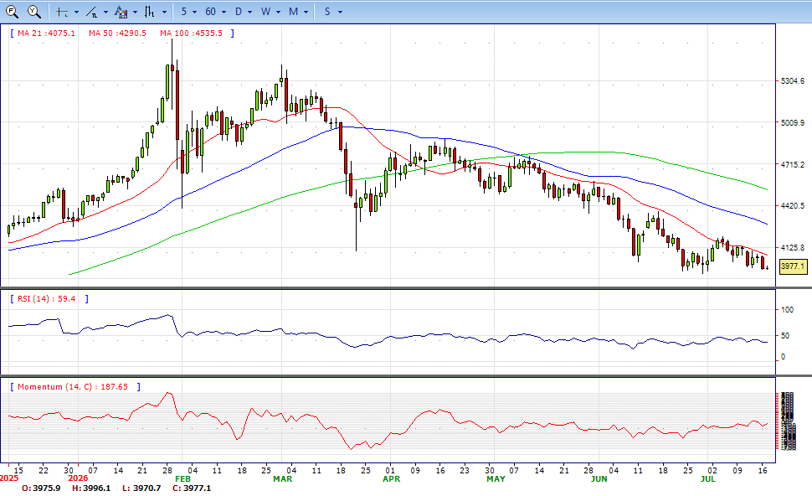
GOLD Daily

Slide 11
USD/JPY
MetaTrader4

Slide 12
Support Level : 160.00 – 158.00– 155.50
Resistance Level : 163.00 – 164.00 – 165.00
USD/JPY
The Japanese Yen (JPY) holds modest gains against the US Dollar (USD) on Thursday following better-than-expected US inflation data. At the time of writing, USD/JPY trades around 162.40.
US Retail Sales rose 0.2% MoM in June, matching expectations but slowing from May’s 1.0% increase. The Retail Sales Control Group advanced 0.5%, also in line with forecasts but below the previous 0.8%, suggesting that consumption momentum moderated. US Initial Jobless Claims fell to 208K in the week ending July 11, below expectations of 217K and the previous 216K. The figures indicate that layoffs remain limited, supporting the Greenback despite signs of softer consumer spending.
The USD/JPY pair is trading near 162.40, slightly up for the day. The pair is above 21 SMA also well about 50 and 100 SMA, indicates bullish strength in short term. Meanwhile, the 21 SMA continued accelerating north and developing above longer ones, suggests bulls not exhausted yet. On upside, the immediate resistance is 163.00, break above this level will extend the advance to 164.00.
Technically RSI stabilizes around 60, while the Momentum indicator stabilizes above the middle line, suggests upward potentials. On downside, the immediate support is 160.00, break below this level will open the gate to 158.00 area.

Slide 13
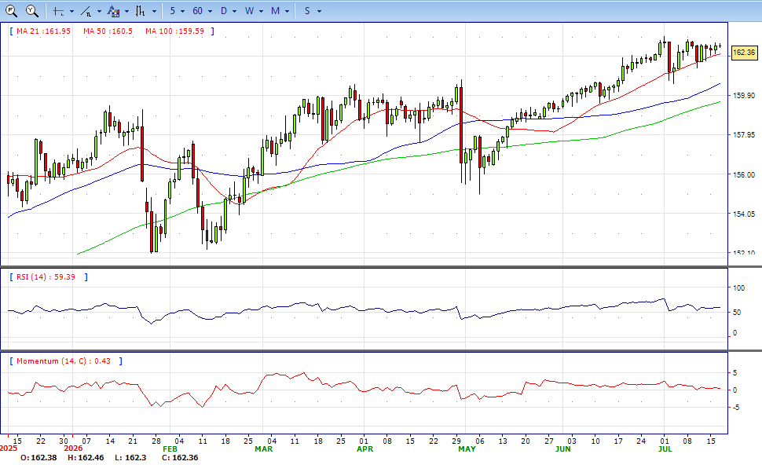
USDJPY Daily

Slide 14

Trading futures, options or foreign currencies involves the risk of loss. You may lose more than the amount originally invested and, in respect of these products traded on margin, you may have to pay additional funds later. You should not invest in such products unless satisfied that they are suitable for you.
MetaTrader4

